Slide 1
Scalable and Probabilistic Leaderless BFT Consensus through Metastability
Team Rocket, Maofan Yin, Kevin Sekniqi, Robbert van Renesse, and Emin Gu ̈n Sirer
Cornell University
Presenter: Jinyue Song

Slide 2
Overview
Snow protocol family
Overview
Protocols
Mechanism
Evaluation

Slide 3
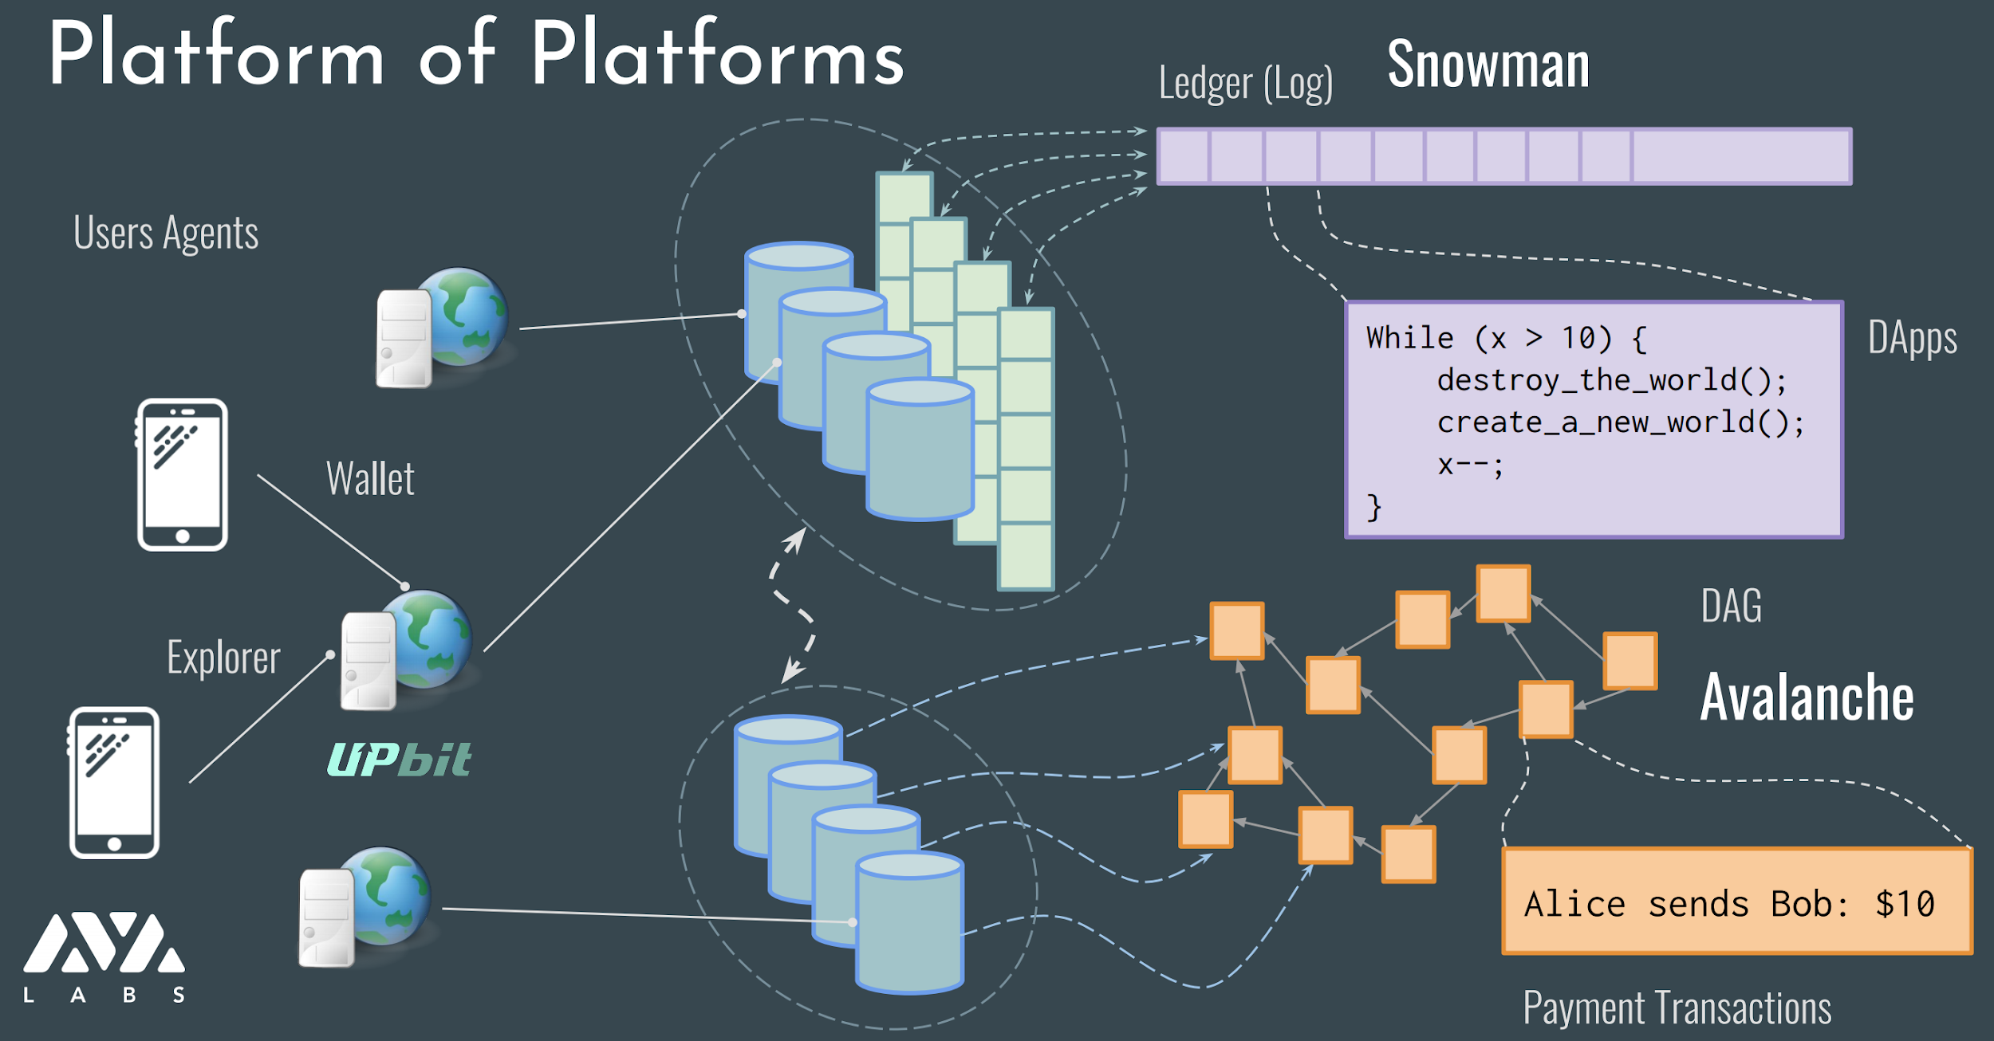
Glance at Avalanche
Pic reference: https://tedyin.com/archive/ava-udc.pdf
Notes:
Avalanche [ˈævəlɑːnʃ]
n. 雪崩
vt. 雪崩
vi. 崩塌

Slide 4
Properties
Probabilistic safety guarantee
Leaderless
O(1) communication overhead and O(log n) rounds expected
Subsampled voting mechanism
Directed Acyclic Graph (DAG) reduces communication cost from O(log n) to O(1) per node

Slide 5
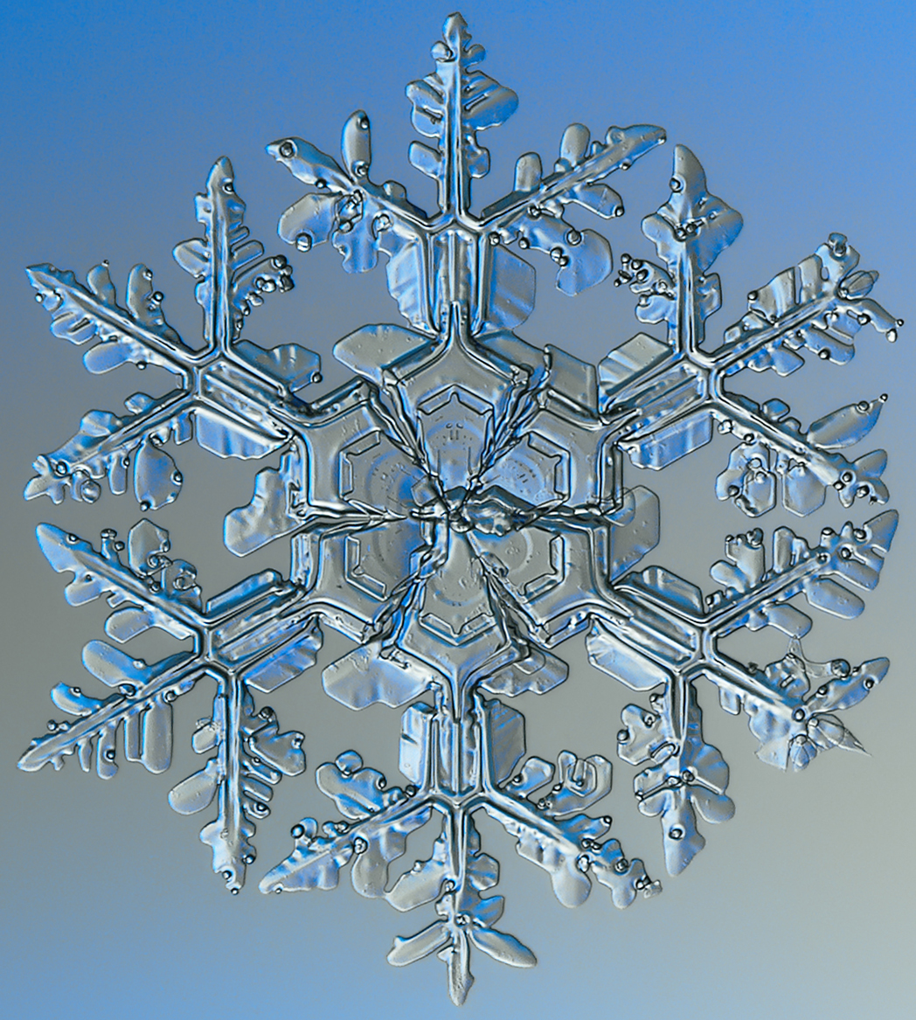
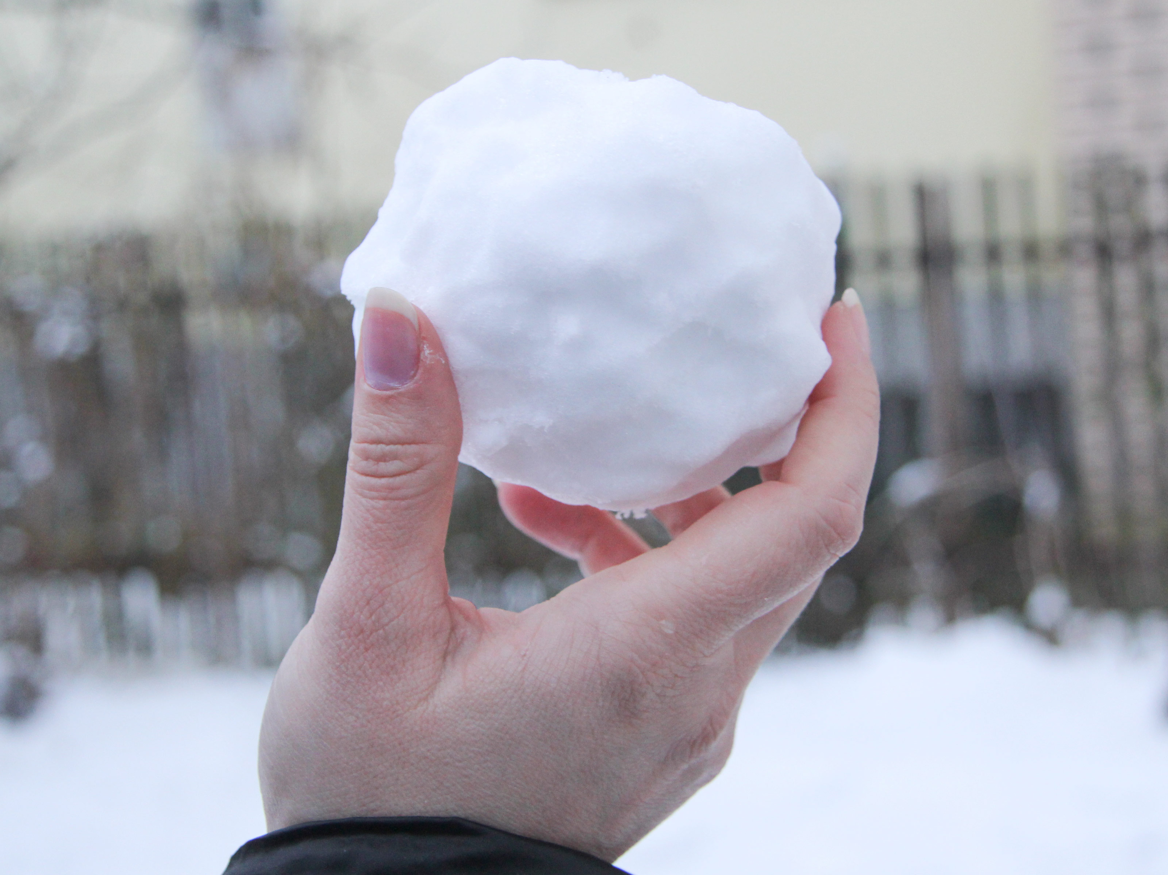
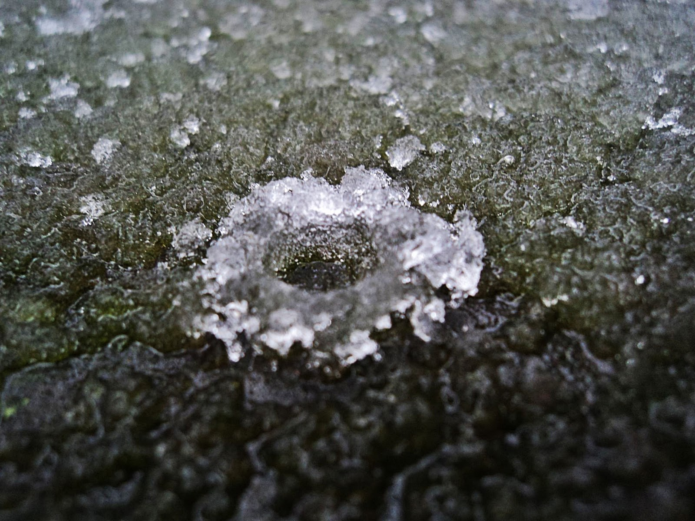
Protocols
Slush
Snowflake
Snowball
Pic reference: https://urbansimplicty.files.wordpress.com/2012/01/splash.jpg
https://en.wikipedia.org/wiki/Snowflake_(slang)#/media/File:Snowflake_macro_photography_1_(cropped).jpg
https://www.wikihow.com/Make-a-Snowball#/Image:Make-a-Snowball-Step-15.jpg
Notes:
We start with a non-BFT protocol called Slush and pro-gressively build up to Snowflake and Snowball, all based on the same common majority-based metastable voting mechanism.
Slush [slʌʃ]
Snowflake [ˈsnəʊfleɪk]

Slide 6
Slush
Notes:
We use color to represent binary values. At first, the sample node does not have a color.

Slide 7
Slush
tx carrying color blue for example
Notes:
The empty node receives a transaction carrying color blue for example.

Slide 8
Slush
2. Update node color
tx carrying color blue for example
Notes:
Then, the node updates itself as blue since it does not have a color

Slide 9
Slush
3. Send queries
2. Update node color
tx carrying color blue for example
Notes:
The node sends queries and communicate with other nodes for color consensus.

Slide 10
Slush
Sample k out of N for m rounds
k: sample size
N: network size
m: round number
Design reference: https://tedyin.com/archive/ava-udc.pdf
Notes:
This nodes broadcasts the query carrying blue to other nodes. This node does not broadcast to everyone, but randomly sends the query to k nodes for m times within the network. N is the network size.

Slide 11
Slush
Respond yellow
White -> Blue
Response color and broadcast
Respond blue
k: sample size
N: network size
m: round number
Design reference: https://tedyin.com/archive/ava-udc.pdf
Notes:
Nodes who receiving the query will response with their color. If it is empty, it will change its color based on the received query. Here we can see the white node becomes blue and it broadcasts its new color. Other nodes just response their current color and no change.

Slide 12
Slush
Blue response ≥
⍺
Yes
Yes
Next round query
Receive k responses?
No
No
Decide node color after round m
Wait for k responses
⍺ > k/2
Notes:
Here is the workflow of Slush protocol. In this example, the empty node becomes blue and sends out k queries. It will wait for k responses. Once it receives k responses, it will check if blue responses is greater than ⍺. ⍺ is a given parameter for nodes to decide to change color. In this example, if greater, this node keeps blue. If no, it changes to the other color. After m rounds, the node color will be decided.

Slide 13
Slush
Issue
Non BFT
Notes:
This protocol has an issue that, it does not provide strong safety guarantee when there are Byzantine nodes.

Slide 14
Snowflake
Respond yellow
cnt
White -> Blue
Response color and broadcast
Respond blue
k: sample size
N: network size
m: round number
Design reference: https://tedyin.com/archive/ava-udc.pdf
Notes:
Here comes the modified protocol, snowflake. The difference is that the node has a counter. When the query has a color responses greater than ⍺, cnt increases. If the node color changes, cnt resets to 0.

Slide 15
Snowflake
Blue response ≥
⍺
cnt += 1
Yes
Yes
Next round query
Receive k responses?
No
cnt
No
Decide node color after round m
Wait for k responses
cnt = 0
⍺ > k/2
Notes:
Here is the snowflake protocol workflow. We can see when the when there are more blue responses than ⍺, cnt + 1, otherwise cnt resets to 0.

Slide 16
Snowflake
Yes,
node confirms to be blue
cnt >= β
Notes:
If cnt greater than β, this node confirms current color blue in this example. β is a given parameter.

Slide 17
Snowflake
When correctly parameterized,
this protocol can ensure both safety and liveness.
system states (colors) are irreversible when decisions are committed by correct nodes.
Notes:
Here are the summary of snowflake.
Snowflake augments Slush with a single counter that captures the strength of a node’s conviction in its current color.

Slide 18
Snowball
+ 1
Blue response ≥
⍺
Blue confidence
Yes
Yes
Next round query
Receive k responses?
No
BC
YC
Yellow confidence
No
Decide node color after round m
Wait for k responses
+ 1
⍺ > k/2
Notes:
Here is the snowball workflow. Now, the node has a new feature called confidence. In this example, the node has blue confidence and yellow confidence. When received blue responses are greater than ⍺, the blue confidence +1 in this example, otherwise, yellow confidence +1. The node will change color when the opposite color confidence is higher.

Slide 19
Snowball
Yes,
node to blue
BC>=YC
Blue Confidence
Yellow Confidence
No,
node to Yellow
Notes:
Here is the graph to show how the node changes color based on color confidence.

Slide 20
Parameters
α: threshold for changing color
β: threshold for node cnt to confirm color
k: sample constant size
N: a set of n nodes represented by N
m: how many rounds to send queries
f: number of adversarial nodes
Notes:
Here are the parameters used in previous protocols.

Slide 21
Safety and Liveness
P1. Safety: Two correct nodes make conflicting transactions, whose probability is smaller than ε.
P2. Liveness (Upper Bound): Snow protocols terminate with a strictly positive probability within t_max rounds.
P3. Liveness (Lower Bound): . If f ≤ O(√n), then the Snow protocols terminate with high probability (≥ 1−ε) in O(log n) rounds.
O(log n) < tmax < ∞ is the upper bound of the execution of the protocols.
Notes:
Here are the safety and liveness. Also, we can know how to get the bound on liveness. Especially how to define the f, m values.

Slide 22
Evaluation
Throughput
Scalability
Cryptography Bottleneck
Latency
Misbehaving Clients
Geo-replication
Comparison to Other System
Notes:
In this paper, the authors spend lots of pages on the evaluation. I will show it from the following 7 sections. In the previous 4 sections, some data is not provided in the paper. I get them from google. So we can have a better and clear comparison.

Slide 23
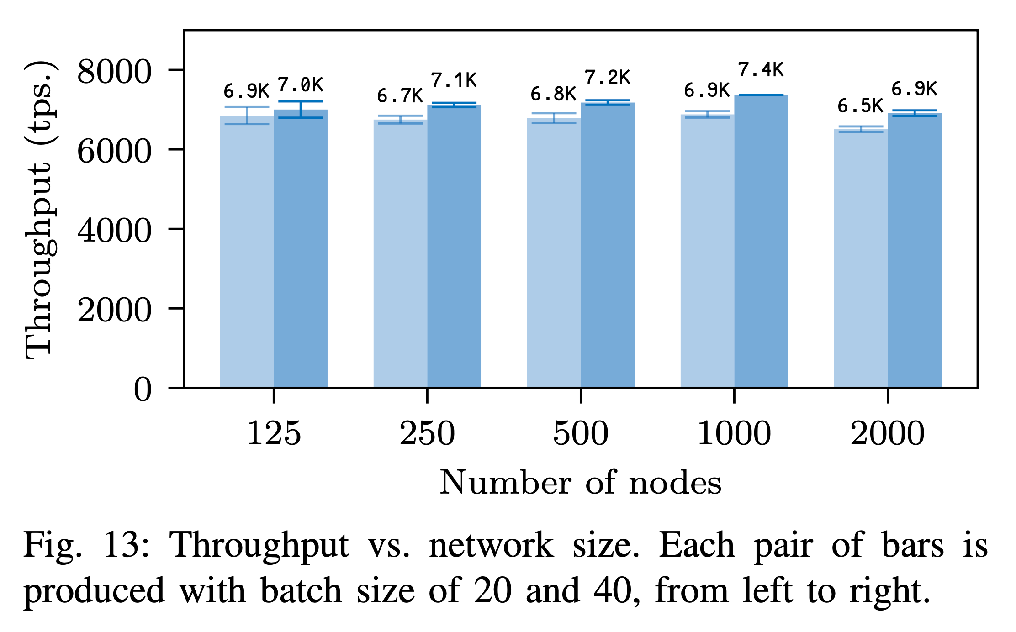
Throughput
Avalanche
System | Batch Size | TPS
VISA | N/A | 2000
Bitcoin | ~2,800 | 4.6
Ethereum | 75 | 15
Algorand | 8.4-41.9K | 1000
Conflux | 16.8K | 6400
Notes:
From throughput view, we can see Avalanche is better on both batch size and transaction per second.
We can see under bath size 20 and 40, tps is around 6.8K and 7.2K, which are better than other protocols no matter the batch size or tps.

Slide 24
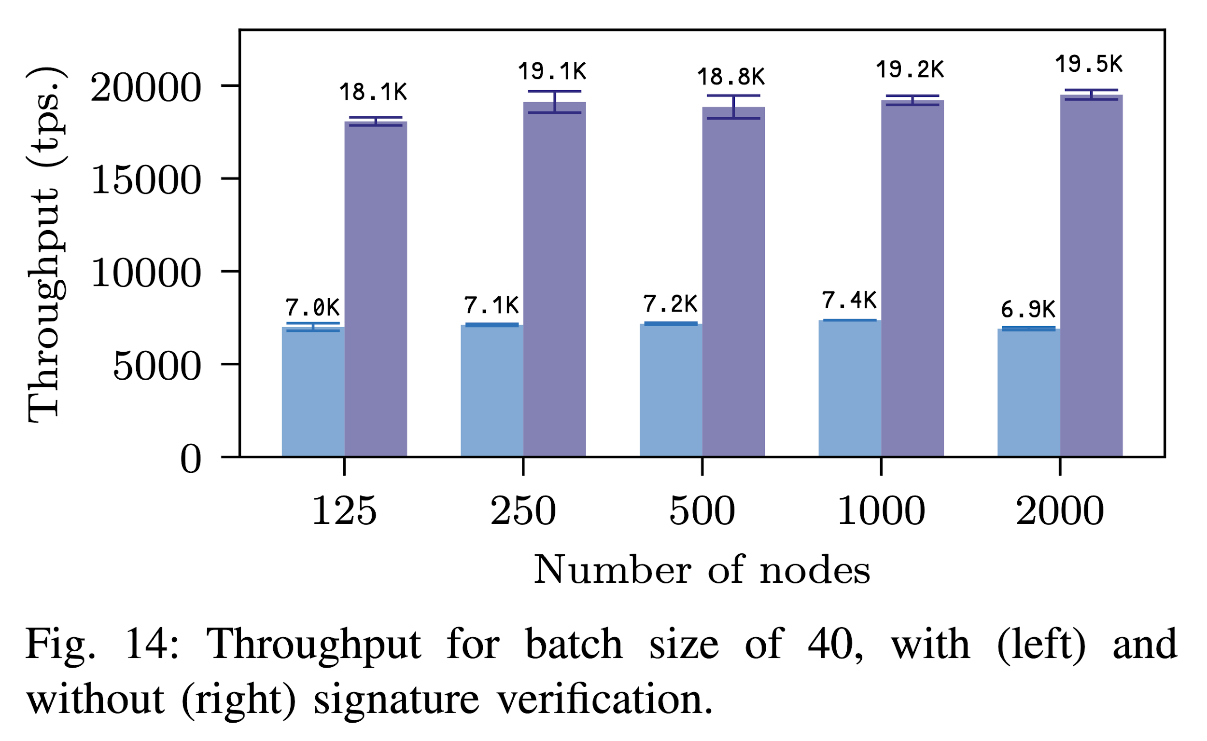
Scalability
Avalanche
System | Nodes Number
VISA | 376 servers
Bitcoin | 9463
Ethereum | 6255
Algorand | 500 (testNet)
Conflux | 20K
Notes:
Avalanche has a good scalability. When node number increases, its throughput does not drop even raises until 1000 nodes. The authors do not provide the data in the table and I collect them from google. We can see for now, this system does not have advantage.

Slide 25
Cryptography Bottleneck
When signature verification is disabled, the throughput is 2.6x higher.
Notes:
Very clear that, the authors point out this system has a bottleneck on cryptography美 [krɪpˈtɑːɡrəfi].
When it is disabled, the throughput is 2.6 times higher.

Slide 26
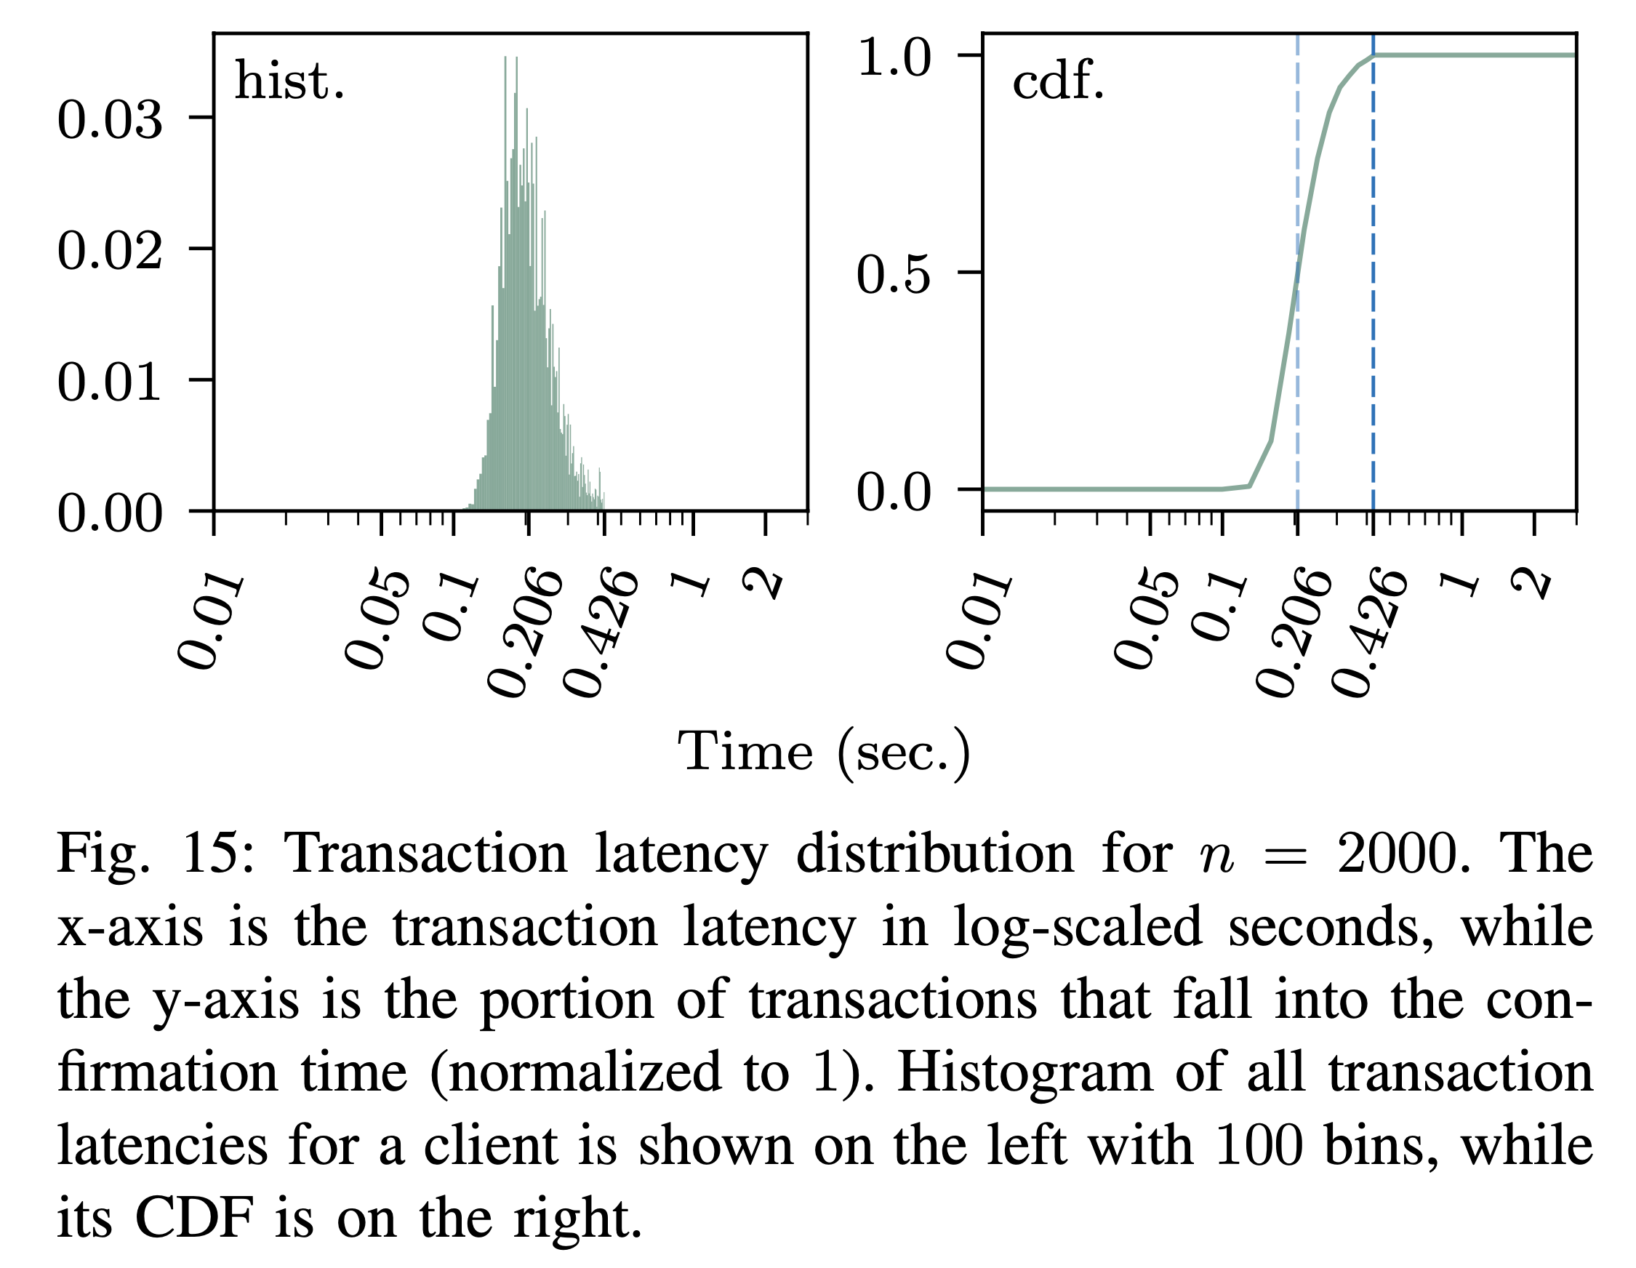
Latency
System | Latency
Avalanche | 0.2~0.3 s
VISA | N/A
Bitcoin | 5 mins
Ethereum | 12.5 s
Algorand | 5 s
Conflux | 4.5-7.4 mins
Avalanche
Notes:
Here are the latency graphes. This system does have great advantage over others. I collect the data in the table from google.
Left graph is the distribution of single tx latency. The right side is about cumulative distribution about accumulated transaction over time. We can see most of them are confirmed between 0.206 and 0.446 s.
Compared with other systems, this one is pretty good.
CDF: cumulative distribution function
Bitcoin 5 mins: https://www.iang.org/papers/BitcoinLatency.pdf
Ethereum 12.5 s: https://ethereum.stackexchange.com/questions/25664/where-is-blockchain-scalability-bottleneck
Algorand 5s:
https://www.algorand.com/resources/blog/success-and-momentum-of-algorand-the-platform--technology
Conflux 4.5-7.4:
https://arxiv.org/abs/1805.03870

Slide 27
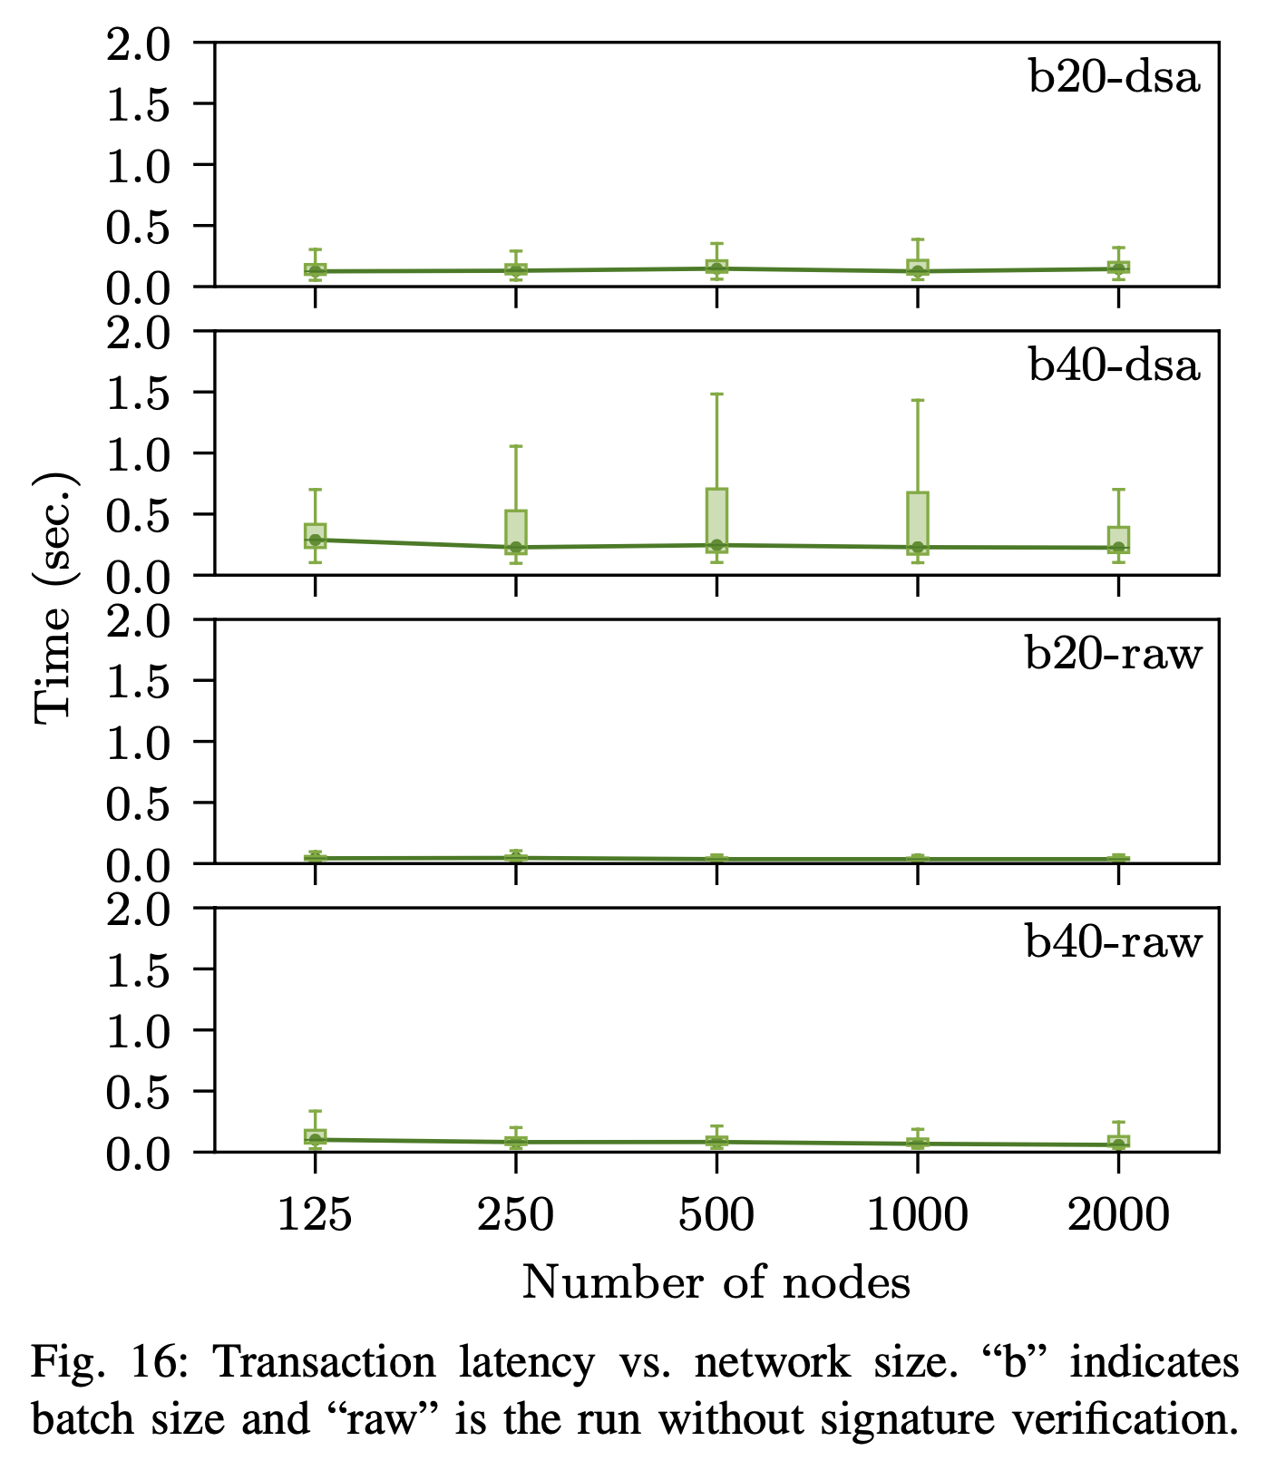
Latency
Avalanche
Notes:
Here is the graph to show latency and node number. Raw means wo signature verification. B is the batch size. We can see when the node number increase, the latency does not change a lot.
CDF: cumulative distribution function
Bitcoin 5 mins: https://www.iang.org/papers/BitcoinLatency.pdf
Ethereum 12.5 s: https://ethereum.stackexchange.com/questions/25664/where-is-blockchain-scalability-bottleneck
Algorand 5s:
https://www.algorand.com/resources/blog/success-and-momentum-of-algorand-the-platform--technology
Conflux 4.5-7.4:
https://arxiv.org/abs/1805.03870

Slide 28
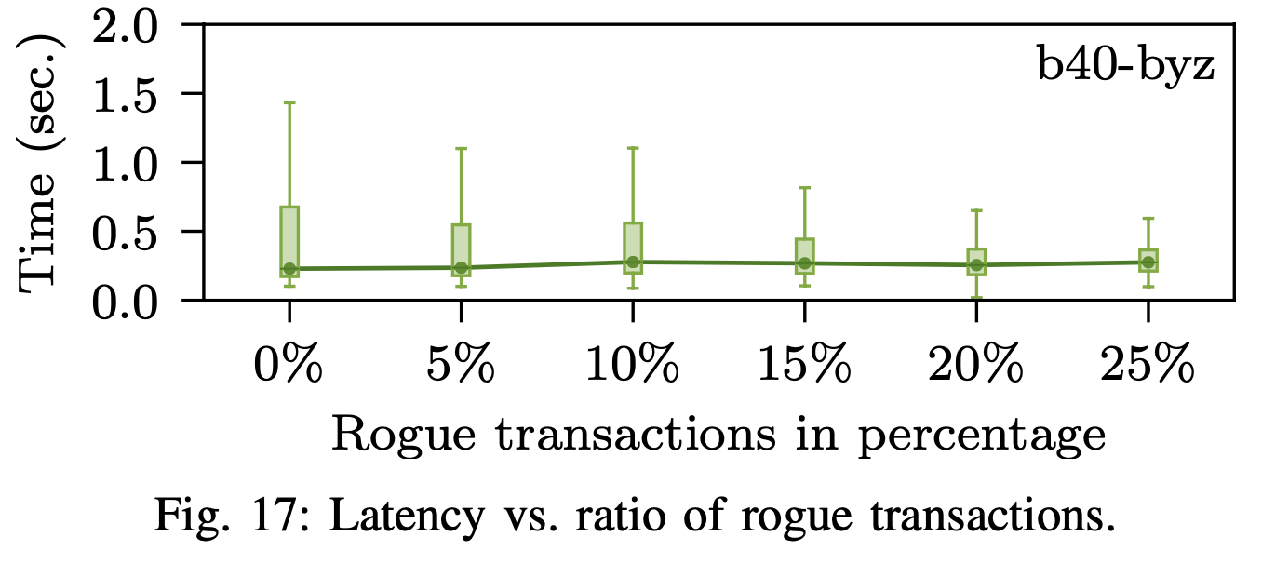
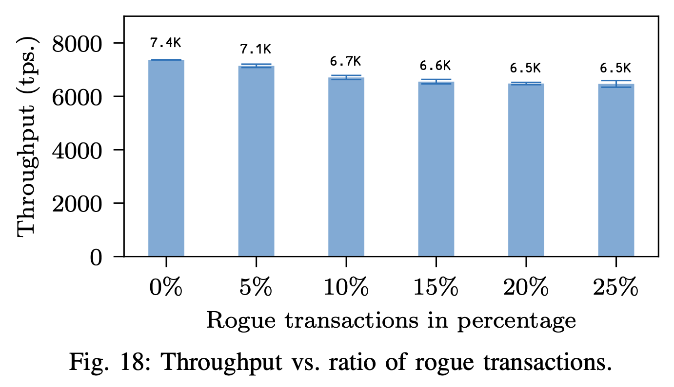
Misbehaving Clients
N = 1000
Rogue tx: double spending
Notes:
Here the graphes show when rogue [roʊɡ] transactions increase, how much latency time increases and how many throughput are affected.
The average latency is slightly affected. But the max latency decreases when rogue tx increases.
The throughput is affected. Its performance drops 12%.

Slide 29
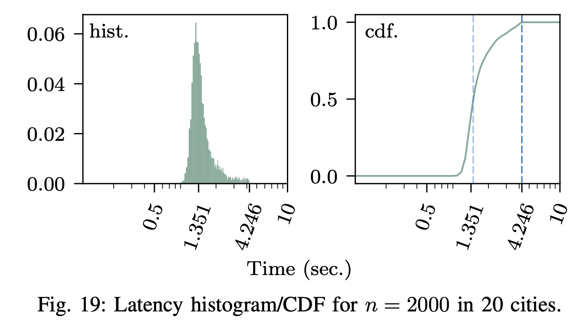
Geo-replication
Geo distribution: 20 Major cities cover North America, Europe, West Asia, East Asia, and Oceania and top 10 countries where bitcoin nodes are highest reachable.
Node number: 2000
Bandwidth: 20Mbps
Notes:
Here are the graphs to show latency distribution when nodes are deployed in 20 cities worldwide. We can see this factor does affect the latency and the performance is 10 times slower than the speed in the AWS.

Slide 30
Comparison to Other Systems
 | Avalanche | Algorand | Conflux | Bitcoin
Style | New algorithm Metastability | Committee-scale consensus Classical BFT | Extends Nakamoto consensus by DAG | Nakamoto
Safety violation Probability (20% Byzantine nodes) | < 10^-9 | < 5*10^-9 | N/A | < 10^-9
Throughput | 3400 | 874 | 3355 | 3-7
Latency | 1.35 s | 50 s | 7.6-13.8 s | 10-60 mins
Leader-base | NO | YES | N/A | NO
Bottleneck | cryptography | Byzantine Agreement | Nakamoto consensus
Notes:
Here is the table to compare four systems from the five aspects. This system has advantages in all three aspects.

Slide 31
Questions

